Slide 1

Deep Learning for NLP
Assignment 1
Kawin M

Slide 2
Text Preprocessing
Sentence:
1) Remove Punctuations:
It's a Wonderful, and Beautiful movie...
It's a Wonderful and Beautiful movie

Slide 3
Text Preprocessing
2) Tokenize (Spacy):
it
's
a
wonderful
and
beautiful
movie

Slide 4
Sentence Representation
For each word, get GloVe and FastText word vectors of dimension 300.
it
's
a
wonderful
and
beautiful
movie

Slide 5
Sentence Representation
Concatenate the obtained word vectors – 600 dimensions.
it
's
a
wonderful
and
beautiful
movie

Slide 6
Sentence Representation
Take the mean of the concatenated word vectors.
+

Slide 7
Training
Shuffled the training data
Train-Validation split of 95 : 05
Set seed for reproducibility
Split them into Batch with size 100

Slide 8
Training
Optimizer – Adagrad
Learning rate – 0.01
Epoch – 25
Loss – Binary Cross-Entropy

Slide 9
Model Architecture
2048
1024
600
512
ReLU
ReLU
ReLU
64
ReLU
1
Sigmoid

Slide 10
Performance
Test accuracy – 81.87
Validation accuracy – 77.6
Train Loss – 23.59

Slide 11
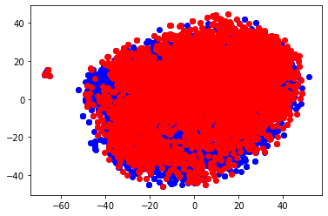
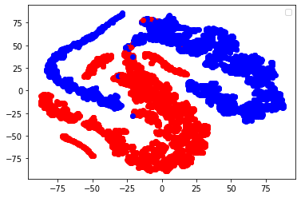
T-SNE plot - Sentence Representations
Train Data
Before Training: After Training:

Slide 12
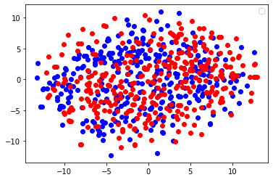
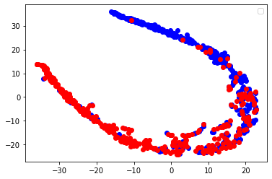
T-SNE plot - Sentence Representations
Test Data
Before Training: After Training:

Slide 13
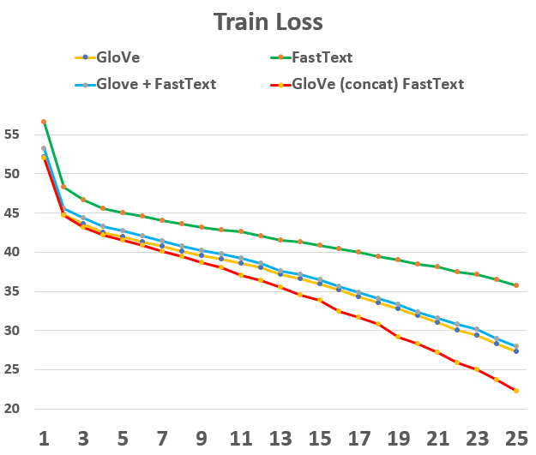
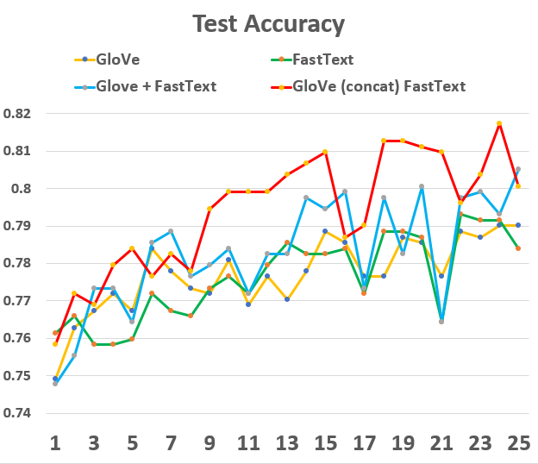
Comparison
Choice of Word Vector representations

Slide 14
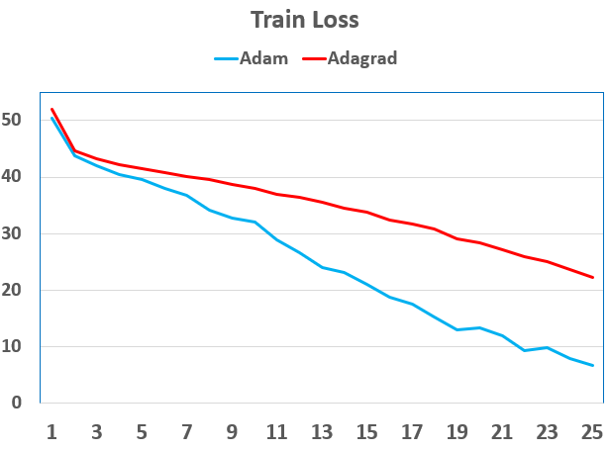
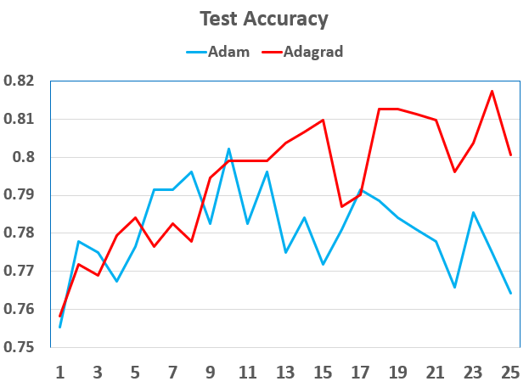
Comparison
Choice of Optimizer

Slide 15
Mispredictions
Double Negations:
Ex: certainly doesn't disappoint. - Positive Sentence
Sarcastic:
Ex: I'm sure there's a teenage boy out there who's dying for this kind of entertainment. - Negative Sentence
Neutral Words:
Ex: a selection of scenes in search of a movie . - Negative Sentence

Slide 16
Thank You

